Slide 1
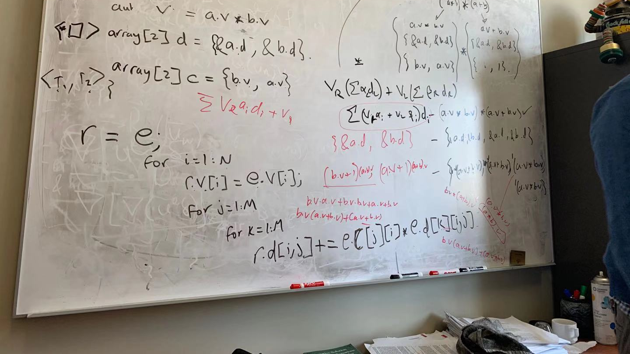
Fully-Explicit 2-Dimension Damped Wave Equation Simulator -- Parallel Computing by OpenMP
Gradate Student Project
Yuxuan Jing
McDougall School of Petroleum Engineering

Slide 2
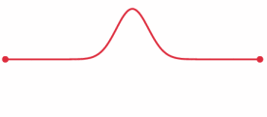
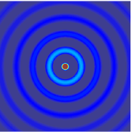
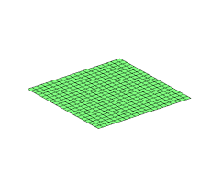
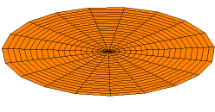
A 1D pulse traveling through a string with fixed endpoints as modeled by the wave equation
Spherical waves coming from a point source.
A solution to the 2D wave equation
A solution of the wave equation in two dimensions with a zero-displacement boundary condition along the entire outer edge.
https://en.wikipedia.org/wiki/Wave_equation

Slide 3

Outline
A quick review of damped wave equation.
Explicit numerical scheme.
Parallel methods and Results
Conclusions

Slide 4
Damped Wave Equation

Slide 5
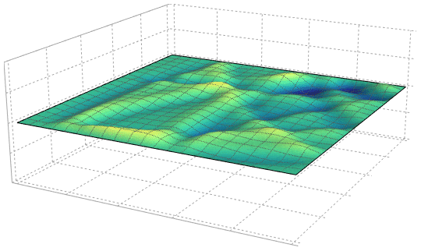
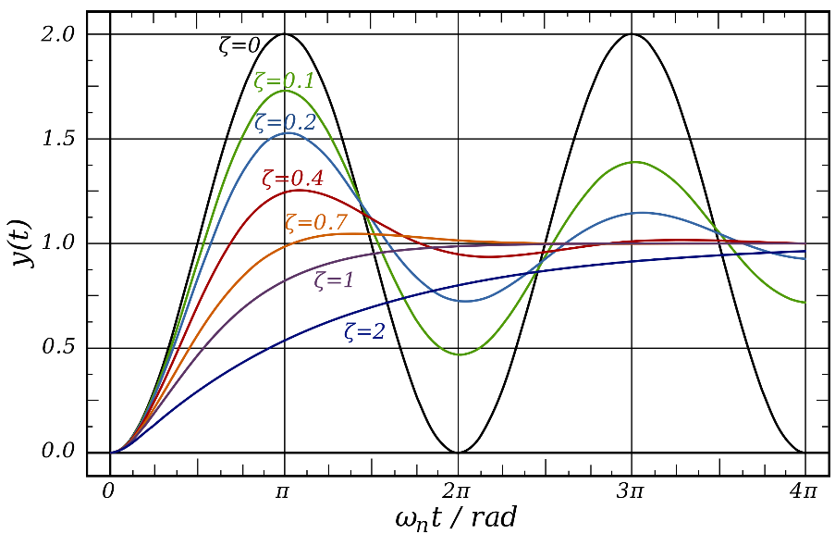
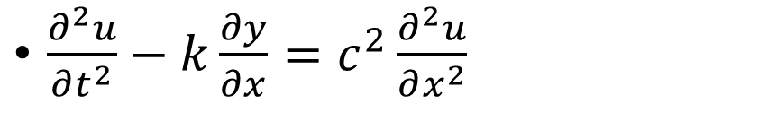
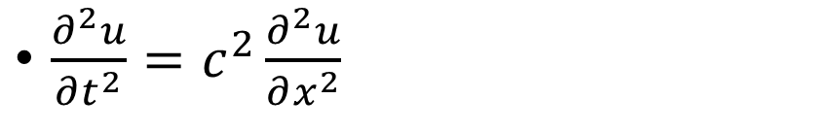
Wave equation
$\frac{∂^{2}u}{∂t^{2}}=c^{2}\frac{∂^{2}u}{∂x^{2}}$
Damped wave equation
$\frac{∂^{2}u}{∂t^{2}}−k\frac{∂y}{∂x}=c^{2}\frac{∂^{2}u}{∂x^{2}}$

Slide 6
Explicit Numerical Scheme

Slide 7
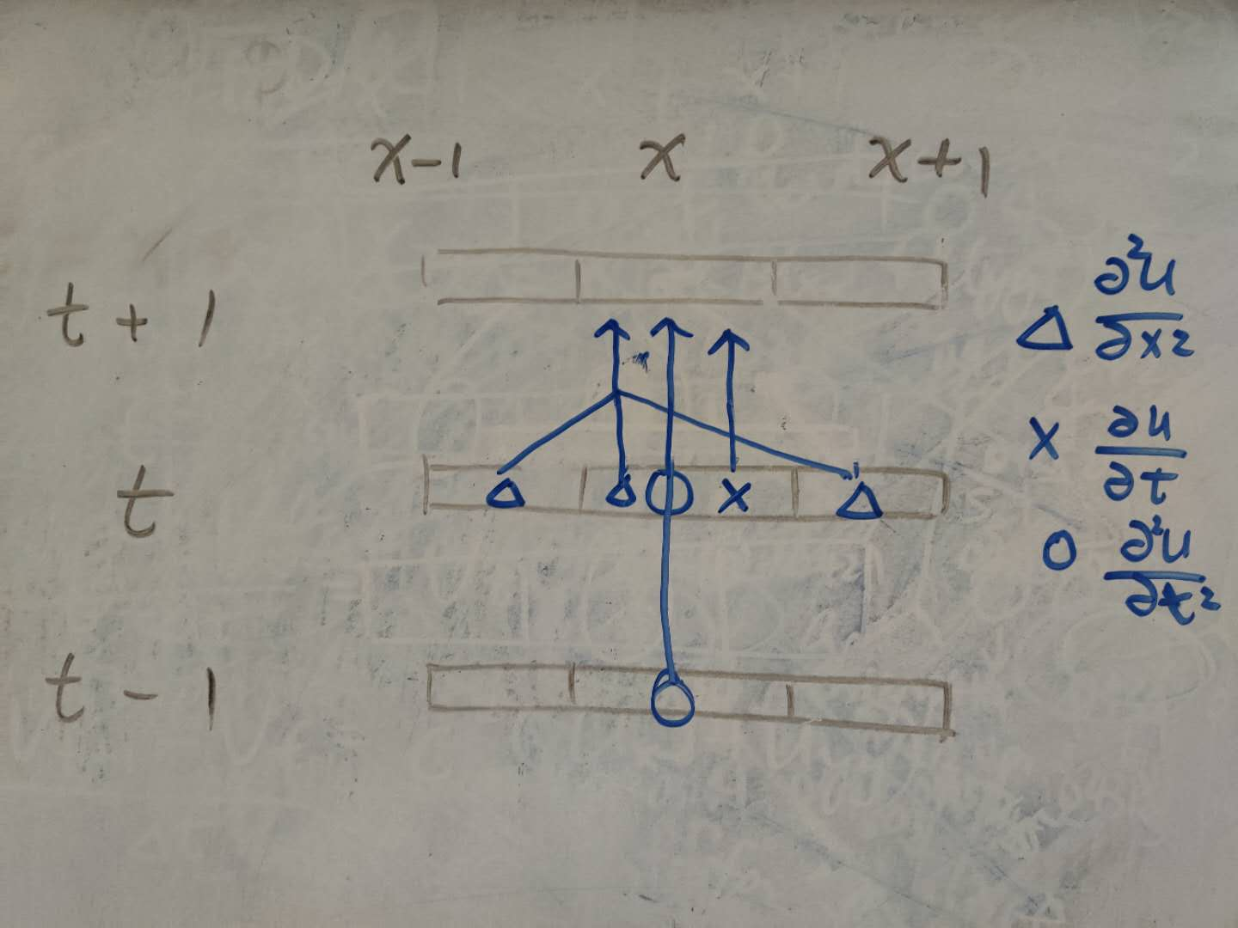
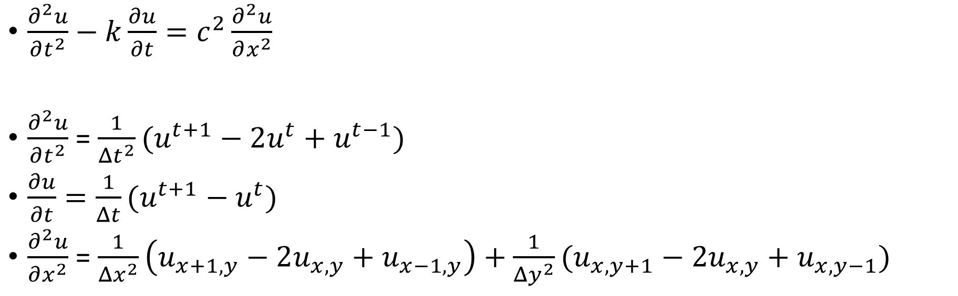
2D numerical discretization
$\frac{∂^{2}u}{∂t^{2}}−k\frac{∂u}{∂t}=c^{2}\frac{∂^{2}u}{∂x^{2}}$
$\frac{∂^{2}u}{∂t^{2}}$ = $\frac{1}{{Δt}^{2}}(u^{t+1}−2u^{t}+u^{t−1})$
$\frac{∂u}{∂t}=\frac{1}{Δt}(u^{t+1}−u^{t})$
$\frac{∂^{2}u}{∂x^{2}}$ = $\frac{1}{{Δx}^{2}}\left(u_{x+1,y}−2u_{x,y}+u_{x−1,y}\right)+\frac{1}{{Δy}^{2}}(u_{x,y+1}−2u_{x,y}+u_{x,y−1})$

Slide 8
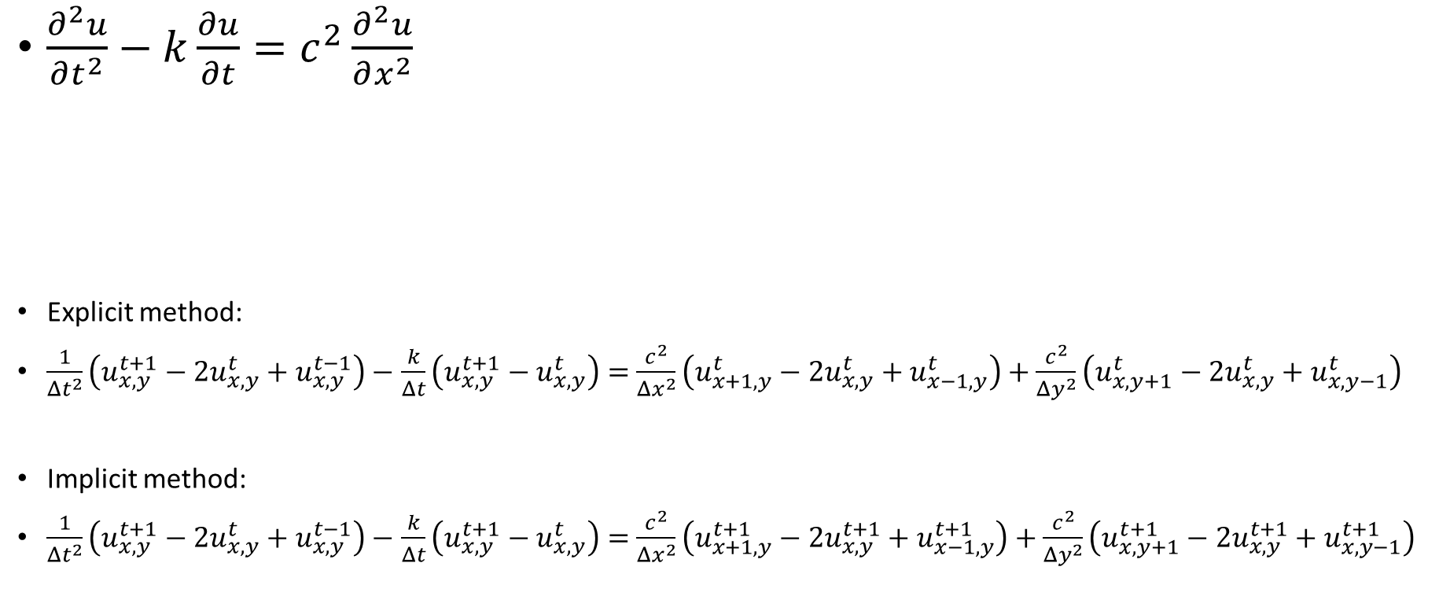
Explicit numerical scheme for wave equation
$\frac{∂^{2}u}{∂t^{2}}−k\frac{∂u}{∂t}=c^{2}\frac{∂^{2}u}{∂x^{2}}$
Explicit method:
$\frac{1}{{Δt}^{2}}\left(u_{x,y}^{t+1}−2u_{x,y}^{t}+u_{x,y}^{t−1}\right)−$ $\frac{k}{Δt}\left(u_{x,y}^{t+1}−u_{x,y}^{t}\right)=$ $\frac{c^{2}}{{Δx}^{2}}\left(u_{x+1,y}^{t}−2u_{x,y}^{t}+u_{x−1,y}^{t}\right)+\frac{c^{2}}{{Δy}^{2}}\left(u_{x,y+1}^{t}−2u_{x,y}^{t}+u_{x,y−1}^{t}\right)$
Implicit method:
$\frac{1}{{Δt}^{2}}\left(u_{x,y}^{t+1}−2u_{x,y}^{t}+u_{x,y}^{t−1}\right)−$ $\frac{k}{Δt}\left(u_{x,y}^{t+1}−u_{x,y}^{t}\right)=$ $\frac{c^{2}}{{Δx}^{2}}\left(u_{x+1,y}^{t+1}−2u_{x,y}^{t+1}+u_{x−1,y}^{t+1}\right)+\frac{c^{2}}{{Δy}^{2}}\left(u_{x,y+1}^{t+1}−2u_{x,y}^{t+1}+u_{x,y−1}^{t+1}\right)$

Slide 9
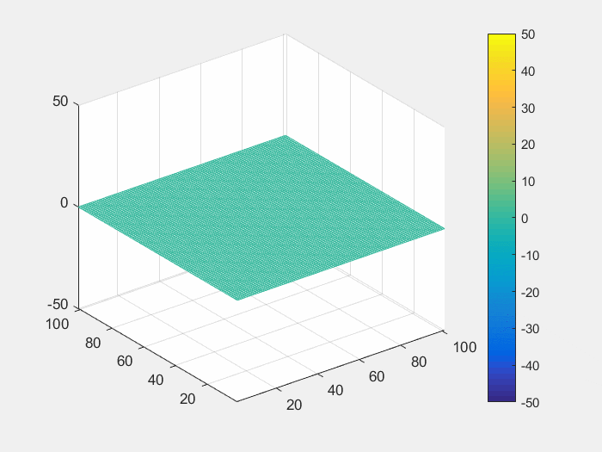

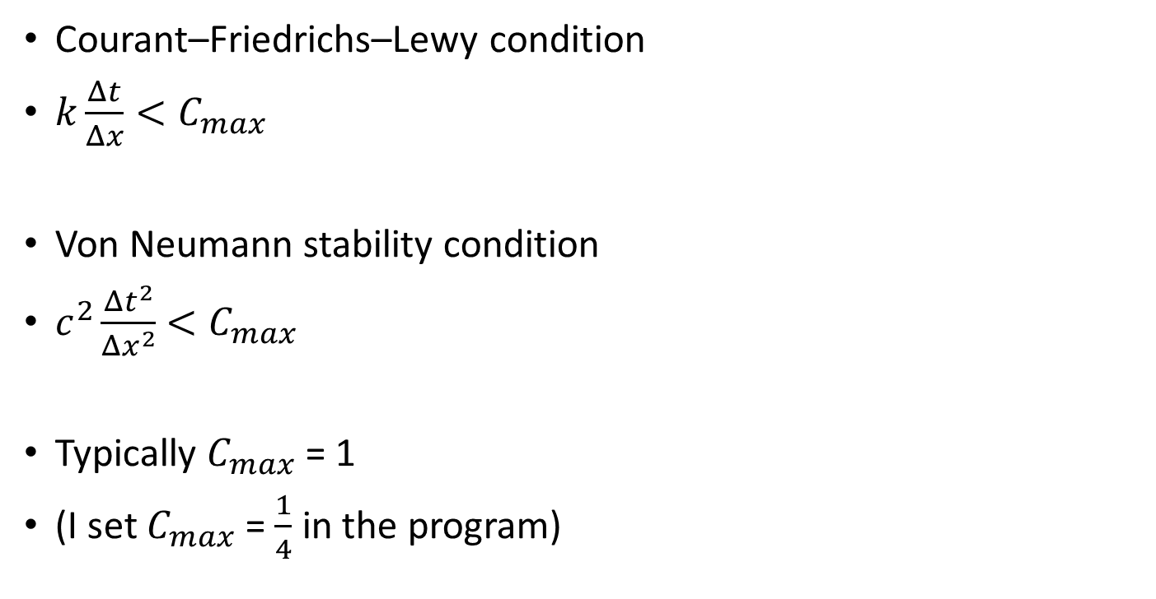
Convergence criteria
Courant–Friedrichs–Lewy condition
$k\frac{Δt}{Δx}<C_{max}$
Von Neumann stability condition
$c^{2}\frac{{Δt}^{2}}{{Δx}^{2}}$ $<C_{max}$
Typically $C_{max}$ = 1
(I set $C_{max}$ = $\frac{1}{4}$ in the program)

Slide 10
Parallel Methods and Results

Slide 11
Parallel programming
Pseudocode:
Input N, M, t_start, t_end, dt, array_N = N*M;
Declare x_pre [array_N], x[array_N], x_next[array_N];
preprocess x_pre, x; //special method
For ( t = t_start; t < t_end; t += dt){ //each time step
#pragma omp directive
for each position: update x_next ;
x → x_pre; x_next → x; initial x_next;
}
Return 0
x_next[] → t+1
x[] → t
x_pre[] → t-1
Set all the array as public value
No lock is needed
Any value as critical will result in inefficiency

Slide 12
Parallel programming
8 * 8 grids
Thread 0
Thread 1
Two <#pragma omp directive> are tried:
Method 1:
#pragma omp parallel for num_threads() shared()
for each position: update x_next ;
Method 2:
#pragma omp parallel thread_count() private() public(){
for distributed position: update x_next ;
}
Thread 2
Thread 3
x_next[] → t+1
x[] → t
x_pre[] → t-1
Set all the array as public value
No lock is needed
Any value as critical will result in inefficiency

Slide 13
Parallel programming
Thread 0
Thread 1
Two <#pragma omp directive> are tried:
Method 1:
#pragma omp parallel for num_threads() shared()
for each position: update x_next ;
Method 2:
#pragma omp parallel thread_count() private() public(){
for distributed position: update x_next ;
}
Method 2 is slightly faster than method 1
(method 2 minimize the miss cache rate)
Thread 2
Thread 3

Slide 14
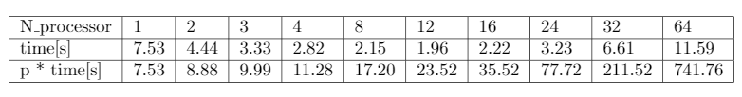
Results

Slide 15
Results
Weakly scalable

Slide 16
Conclusion
Using fully explicit numerical scheme on 2D Cartesian mesh for damped wave equation is feasible.
Courant–Friedrichs–Lewy condition and Von Neumann stability condition are both necessary conditions for the stability of this numerical scheme
For parallel OpenMP for loop, manually distributing the computation is more effective then the default distribution
This program is weakly scalable

Slide 17
END

Slide 18
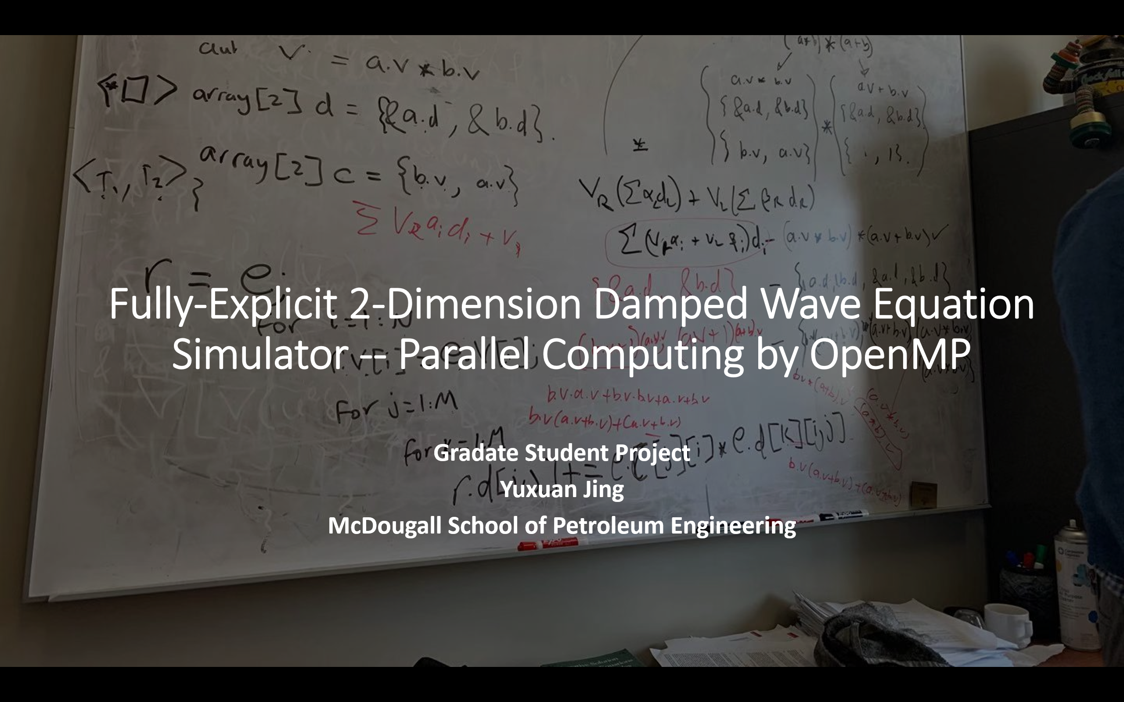
Roofline-Ideal and Generic Automatic Differentiation: Multi-X, SIMD, Multi-Core, and Distributed System
Yuxuan Jing
Ph.D. candidate

Slide 20
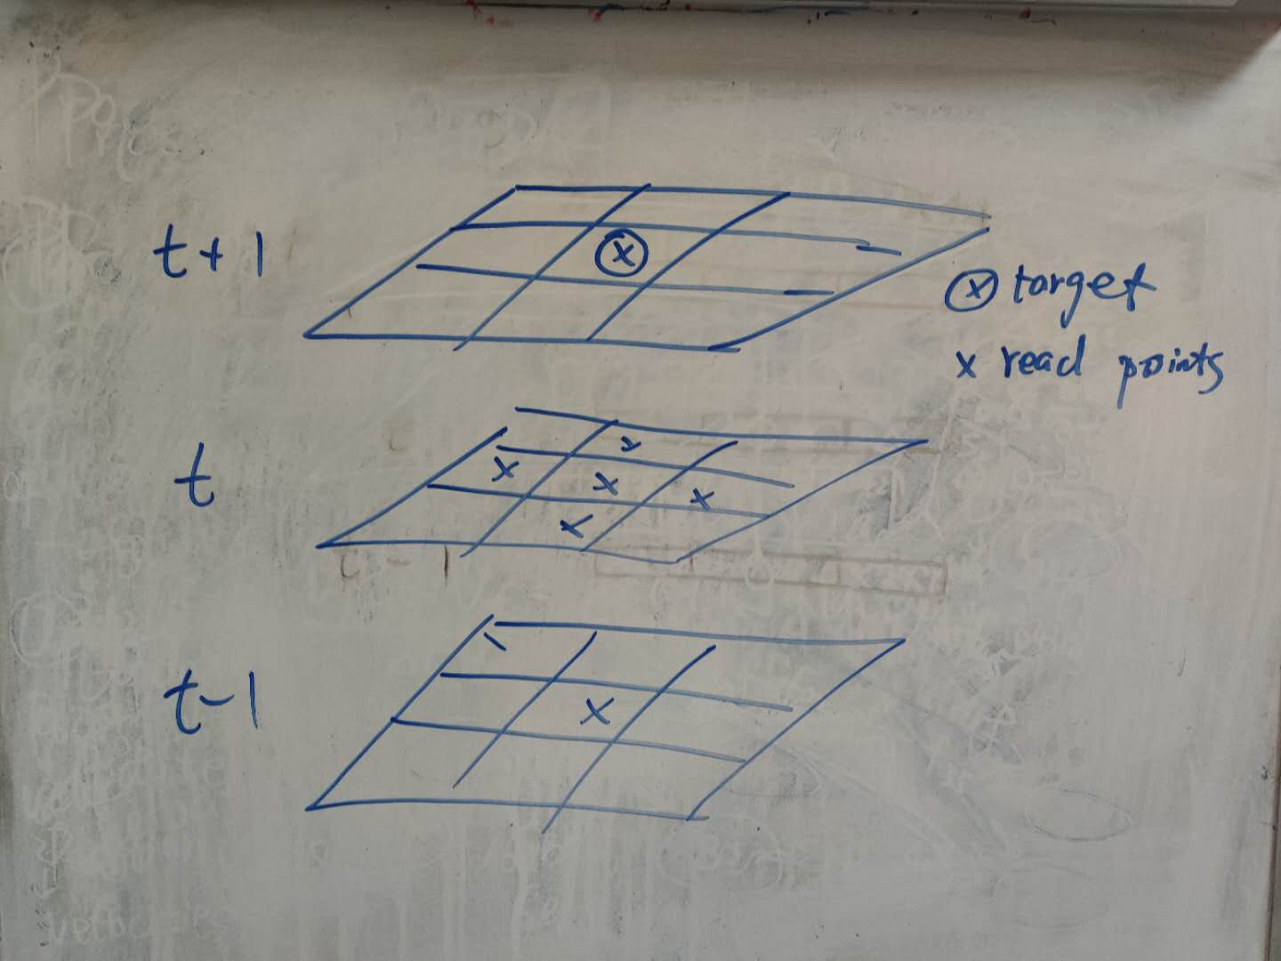
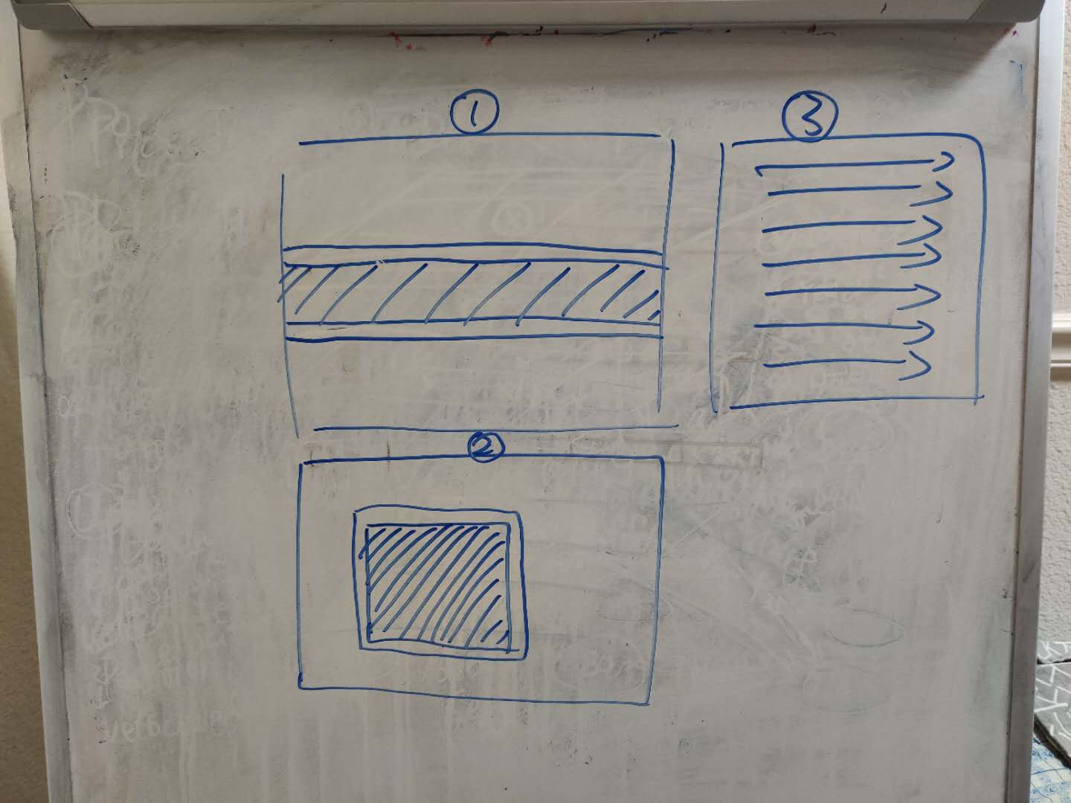
Cache miss rate

